Slide 1
07 - Reinforcement Learning 08 – Learn to Search and Play Games
CSCI 561 Foundation for Artificial Intelligence
Professor Wei-Min Shen
University of Southern California

Slide 2
Outline
Motivation
Agent and Environment (Search & Games)
States, actions, utility, rewards, policy
Utility value iteration
Policy Iterations
Reinforcement Learning
Model-based
Model-free
Q-Learning
State space for advanced game playing

Slide 3
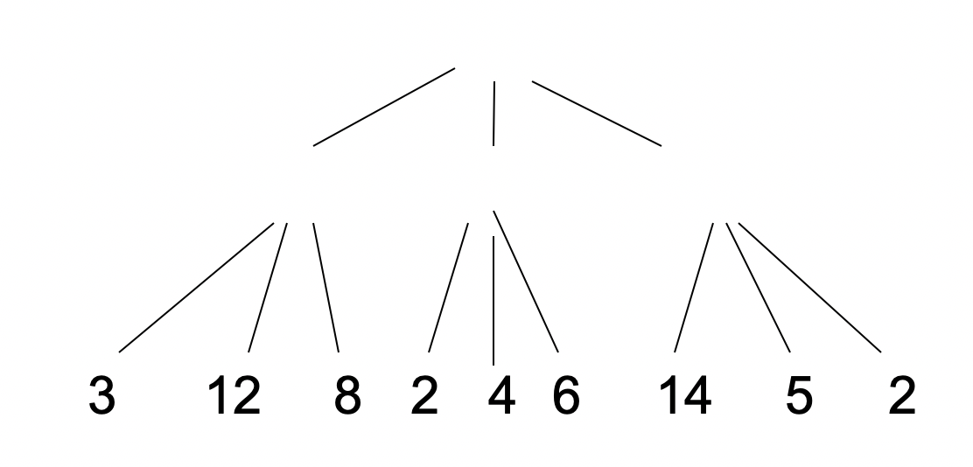
A Key Question
In all search and game playing problems, what is the key information that you wish to have for finding the optimal solution?
What you wish to have but may not always have?
?
?
?
win
+1
lose
-1
draw
0
Notes:
A “crystal ball” for all future costs or values !!! Draw a picture of the search tree.

Slide 4
The True Future Values (Only if we would know them !)
G₁
win
n=?
h(i)
c_{i}
i
lose
now
S₀
n-1
c_{j}
j
h(j)
G₂
win
c_{k}
Past Cost g(n-1)
you know it
k
lose
h(k)
f(n) = g(n)+h*(n)
Future Cost Values
The true h*(n) is unknown
We can only estimate it by h(n)
Can we do better?
f(n) = g(n)+h(n)
win
G₃

Slide 5



Agent and Environment
Sensors
percepts
Environment
Agent
Intelligence
Agent
actions
Effectors

Slide 6
Agent, Environment, Game
Sensors
Agent
percepts
Environment
Intelligence
Agent
actions
Effectors

Slide 7

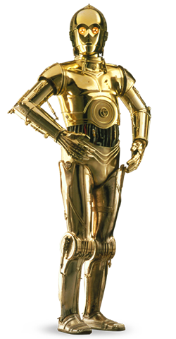

Agent and Environment (Star War)
1 | 2 | 3 | 4
5 |  | 6 | 7
8 | 9 | 10 | 11
Agents:
R2D2
3PIO
Darth Vader
States: 1,..,11
Actions: ^,v,>,<
Percepts: …
Goals:…
Rewards: …
State Utility Values: …
(your “crystal ball”)

Slide 8
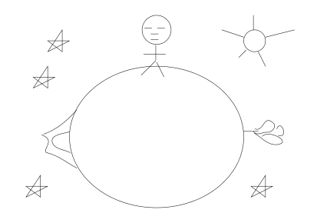
Agent and Environment The Little Prince’s Planet
Percepts: {rose, volcano, nothing}
Actions: {forward, backward, turn-around}
States: {north, south, east, west}

Slide 9
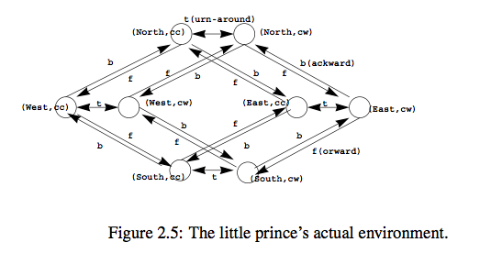
The Little Prince Planet Environment
See Nothing
See Volcano
See Rose
See Nothing

Slide 10
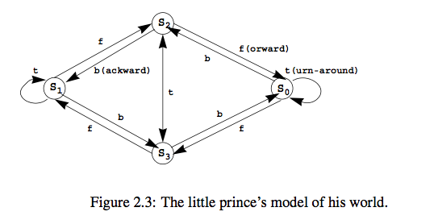
A Model for Little Prince’s Planet
See Nothing
See Rose
See Volcano
See Nothing
His internal action model only needs 4 states! (why?)

Slide 11
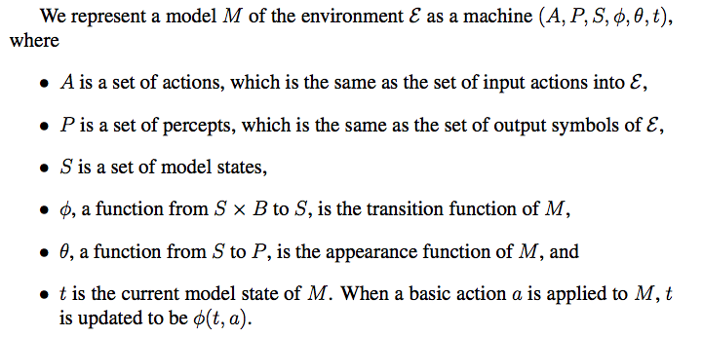
State, Action and Sensor Models

Slide 12
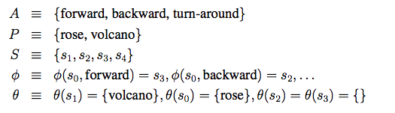
Little Prince’s Model
, nothing}
Transition Model φ can be deterministic or probabilistic
Sensor Model θ can be deterministic or probabilistic
Are the transition model φ here deterministic?
Are the sensor model θ deterministic?
Is there any hidden states in this example?

Slide 13
The Environment may be Uncertain
“Seeing may not always be believing”
States and observations are not always 1-1 mapping
One state may be seen in many different ways
The same observation may be seen in many different states
E.g., When the Prince sees nothing, where is he? Facing which way?
Can you make the little prince’s sensors non-deterministically?
“Action may not always produce the same result”
Actions do not always take you to the same states
E.g., the Little Prince’s planet may have “planet-quakes” ☺
E.g., step forward on ice may not always succeed
Transitions between states by actions may be nondeterministic
E.g., Star War’s transitions are not deterministic
Can you make the Little Prince’s actions non-deterministically?

Slide 14
Sensors can be uncertain (in real world)
Speech Recognition
“Listening is not always equal to hearing” ☺
Traveling through rooms with colored walls
“Seeing does not always tell where you are” ☺
Room-1
Room-2
Room-3
a₀
a₁
a₂
a₃
Wall-color
Wall-color
Wall-color

Slide 15
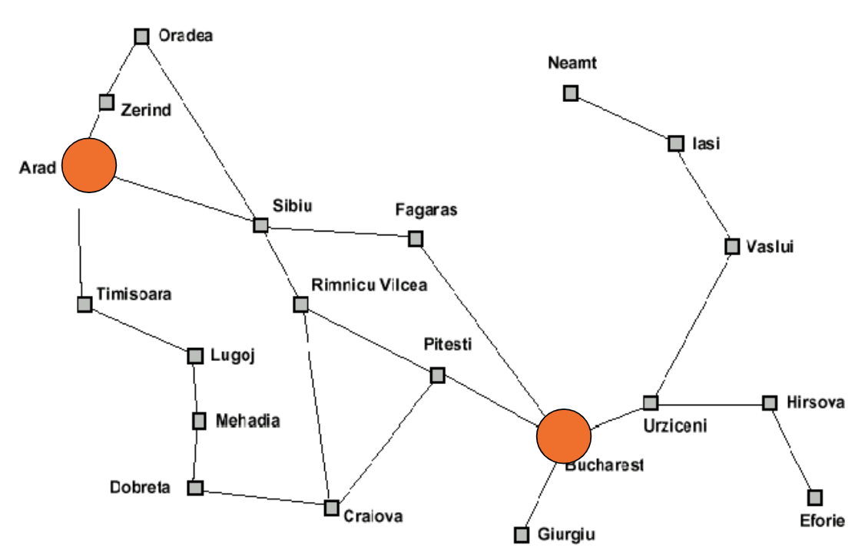


Actions can be uncertain (in real world)
Deterministic actions
Non-deterministic actions (e.g., walking on ice)
Step-forward
Intended
1.0 (100%)
0.1
Step-forward
Intended
0.8
0.1

Slide 16
Other Uncertainties in the Real World
Multiple Agents
The actions of other agents in the environment may be ”uncertain” from your point of view !
Advanced Game Playing
Your opponent’s moves are definitely “uncertain” from your point of view !
When you driving on a highway
What are uncertain?

Slide 17
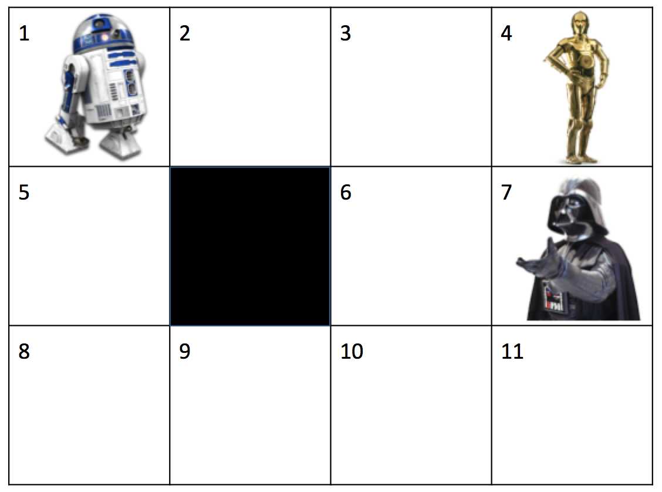
Star War’s Probabilistic Transition Model
Transitions can be probabilistic
P(state_{t+1} | state_{t}, action_{t})
X_{t-1} | A_{t-1} | P(X_{t}=1) | P(X_{t}=2) | P(X_{t}=3) | P(X_{t}=4) | P(X_{t}=5) | ...
1 | up | 0.8+0.1 | 0.1 | 0.0 | 0.0 | 0.0
1 | down | 0.1 | 0.1 | 0.0 | 0.0 | 0.8
1 | left | 0.8+0.1 | 0.0 | 0.0 | 0.0 | 0.1
1 | right | 0.1 | 0.8 | 0.0 | 0.0 | 0.1
2 | up | 0.1 | 0.8 | 0.1 | 0.0 | 0.0
...
0.1
Intended
0.8
0.1
Bounce back
if hits a wall

Slide 18
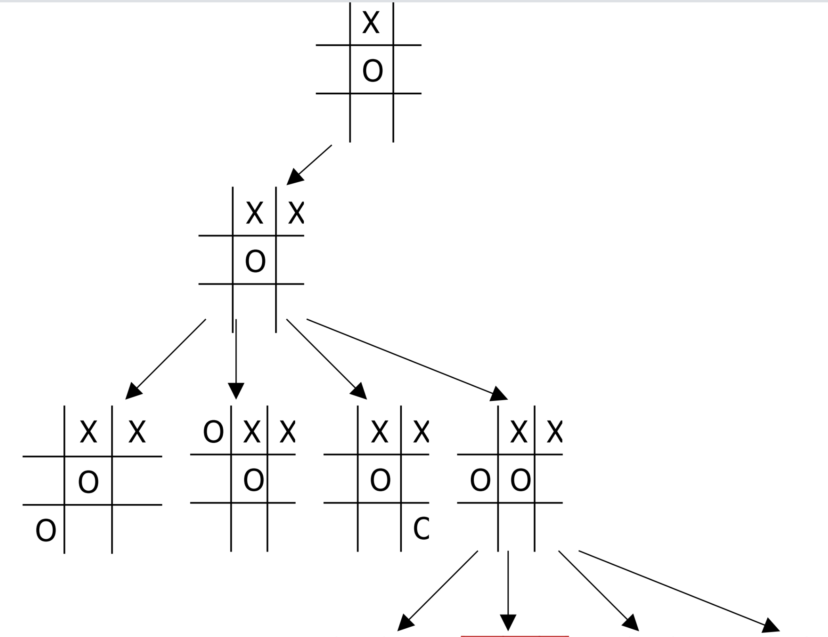
In Game Playing: Opponent’s Actions are not certain
State
You Move
The result state of your move
Is not certain because it will be decided by your opponent
0.1
0.1
0.7
0.1
Therefore, it is appropriate to use:
P(next_state | current_state, your_move)

Slide 19
The Key Representations
Model the environment by States, Actions, Percepts, and
Transition (action) model φ = P(s_{t+1}|s_{t},a_{t}) may be probabilistic
Sensor Model θ = P(z|s) may be probabilistic
States may have Utility Value U(s) or V(s)
Agents may receive Reward r (implicit “goals”) occasionally:
rewards may be given to agent in different format or time
Behaviors may be represented as Policy: state -> action
Objective: find the optimal policy based on utilities and rewards

Slide 20
Certainty vs. Uncertainty
The certain way
s1
a1
s2
The uncertain way
S1 is not always blue
S2 is not always red
s1
a1
s2
0.1
a1
Intended
0.8
a1
s3
0.1
“a1” from S1
does not always go to S2
s3

Slide 21
Uncertainty in Sensor & Actions
S?
S19
a
S?
State, action
S?
Observations
?
?
?
?
?
Solution: let’s use probabilities
Action/Transition Model (for states and actions)
Use Probabilistic Transitions P( NextState | CurrentState, Action)
Sensor Model (for states and observations)
P( Observations | State )

Slide 22
Hidden Markov Model (with actions)
z2
z1
z3
z1
s23
a1
s94
a1
1. Actions
2. Percepts (observations)
3. States
4. Appearance: states -> observations
5. Transitions: (states, actions) -> states
6. Current State
a1
s77

Slide 23
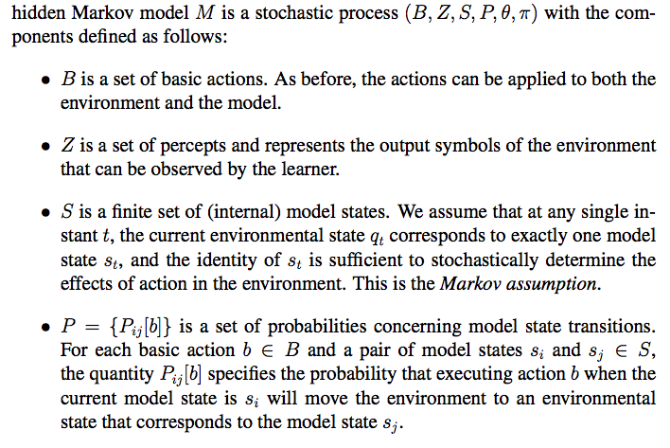
Hidden Markov Model (1/2)
Action Model

Slide 24
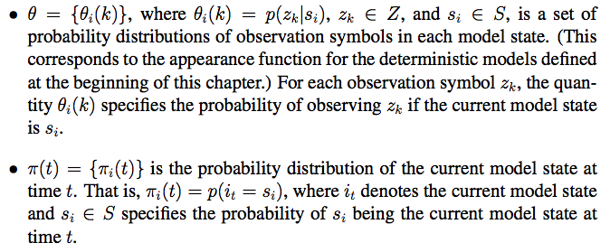
Hidden Markov Model (2/2)
Sensor Model
This is also called “localization”

Slide 25
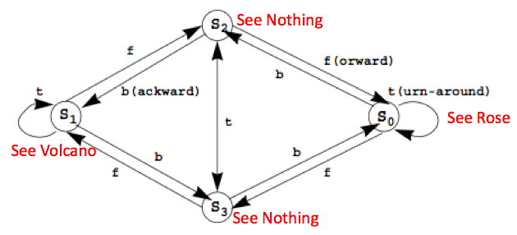
The HMM for Little Prince’s Planet (with uncertain actions and sensors)
{f, b, t}
, nothing}
{P(s₃|s₀,f)=.51, P(s₂|s₁,b)=.32, P(s₄|s₃,t)=.89, …}
{P(rose|s₀)=.76, P(volcano|s₁)=.83, P(nothing|s₃)=.42, …}

Slide 26
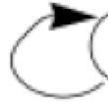
Little Prince Example (may add Rewards)
(action) Transition Probabilities φ (Fwd, Back, Turn)
(sensor) Appearance Probabilities θ
Initial State Probabilities π
F | S0 | S1 | S2 | S3
S0 | 0.1 | 0.1 | 0.1 | 0.7
S1 | 0.1 | 0.1 | 0.7 | 0.1
S2 | 0.7 | 0.1 | 0.1 | 0.1
S3 | 0.1 | 0.7 | 0.1 | 0.1
B | S0 | S1 | S2 | S3
S0 | 0.1 | 0.1 | 0.7 | 0.1
S1 | 0.1 | 0.1 | 0.1 | 0.7
S2 | 0.1 | 0.7 | 0.1 | 0.1
S3 | 0.7 | 0.1 | 0.1 | 0.1
T | S0 | S1 | S2 | S3
S0 | 0.7 | 0.1 | 0.1 | 0.1
S1 | 0.1 | 0.7 | 0.1 | 0.1
S2 | 0.1 | 0.1 | 0.1 | 0.7
S3 | 0.1 | 0.1 | 0.7 | 0.1
θ | Rose | Volcano | Nothing
S0 | 0.8 | 0.1 | 0.1
S1 | 0.1 | 0.8 | 0.1
S2 | 0.1 | 0.1 | 0.8
S3 | 0.1 | 0.1 | 0.8
π | S0 | S1 | S2 | S3
 | .25 | .25 | .25 | .25
You may add rewards to states (e.g., prefer to see rose)

Slide 27
Experience and State Sequence
E_{1:T} is an experience which is a sequence of
{observe₁, act₁, observe₂, act₂, …., act_{T-1}, observe_{T}}
E_{1:T} = {o₁, a₁, o₂, a₂, o₃, …, o_{T-1}, a_{T-1}, o_{T}}
X_{1:T} is a sequence of states that may be hidden but correspond to the experience
X_{1:T} = {X₁, X₂, X₃, …, X_{T-1}, X_{T}}

Slide 28
Little Prince Example
From an “experience” (time₁ through time_{t})
Infer the most likely “sequence of states”
{rose}, forward, {.}, …, turn, …, {rose}, bwd, {volcano}
S1 S2 S3 S4
S1 S2 S3 S4
S1 S2 S3 S4
S1 S2 S3 S4
……
Find the “best sequence of (hidden) states” that support the experience!

Slide 29
Action and Sensor Models (review)
z2
z1
z3
z1
s23
a1
s94
a1
1. Actions
2. Percepts (observations)
3. States
4. Appearance: states -> observations
5. Transitions: (states, actions) -> states
6. Current State
a1
s77
What about the goals?

Slide 30
Utility Value of States Utility Value ⬄ Goal Information
z2
z1
z3
z1
s₂₃
a₁
s₉₄
U(s₂₃)=0.4
1. Actions
2. Percepts (observations)
3. States
4. Appearance: states -> observations
5. Transitions: (states, actions) -> states
6. Current State
7. Rewards: R(s) or R(s,a) (related to the goals, given to the agent)
(8) Utility Value of States: U(s) (how good for the goals, must compute)
a₂
U(s₉₄)=0.2
s₇₇
U(s₇₇)=0.4

Slide 31
Rewards and Utilities
Three types of rewards for agents
Being at a state R(s), e.g., holding an ice cream
Do an action on a state R(s, a), e.g., eating the ice cream
Making a transition R(s, a, s’), e.g., feeling good after eating
Every state may have a Utility Value U(s) or V(s)
Rewards and Utility for R2D2:
X_{t} | Reward | Utility
4 | +1 | 0.0
7 | -1 | 0.0
Else | -0.04 | 0.0
Given
To be learned

Slide 32
Rewards (caution, 3 types)
Three types of rewards for agents
Being at a state R(s), e.g., holding an ice cream
Do an action on a state R(s, a), e.g., eating the ice cream
Making a transition R(s, a, s’), e.g., feeling good after eating
s₅
R(s₂₃, a₄)= -4.8
a₄
a₉
s₁₁
a₄
s₂₃
s₂₃
s₂₃
a₉
a₁
a₁
R(s₂₃,a₉,s₅)= 0.2
R(s₂₃,a₉,s₁₁)= 0.8
R(s₂₃,a₉,s₃₆)= 0.2
R(s₂₃, a₉)= +7.3
s₃₆
R(s₂₃)=5.0
R(s₂₃, a₁)= +5.1
Type I: R(s)
Type II: R(s,a)
Type III: R(s,a,s’)
Notes:
R(s,a) is action reward, every time you're in state s and you perform action a you will receive reward
R(s,a) (no matter what state you arrive after the action)
R(s,a,s′) is action reward with destination, it's similar to R(s,a) but you only get reward R(s,a,s′) if the action lead you to state s′

Slide 33
Reward and Action Example
-0.04 | -0.04 | -0.04 | +1
-0.04 |  | -0.04 | -1
-0.04 (start) | -0.04 | -0.04 | -0.04
0.1
Intended
0.8
0.1
Actions: >, <, ^, v,
outcome probability:
0.8 for the intended
0.2 sideways
// bounce back if hits wall
// In a terminal state, the probability
// to go anywhere is 0.0
Rewards (not utility) as shown:
Two terminal states: -1, +1 (goal)
-0.04 for all nonterminal states

Slide 34
State Utility Value Example
? | ? | ? | ?
? | ? | ? | ?
? | ? | ? | ?
0.1
Intended
0.8
0.1
State Utility Values:
Must be learned or computed by the agent
Initially, could be all 0.0

Slide 35
Little Prince in Action (POMDP)
E_{1:T}
{rose}, fward, {none}, …, turn, {rose}, back, {volcano}
time
Partially
Observable
S1 S2 S3 S4
S1 S2 S3 S4
S1 S2 S3 S4
S1 S2 S3 S4
……
Given: “experience” E_{1:T} (time 1 through T)
Definitions:
State S and actions A (Forward, Back, Turn)
(Action model) Transition Probabilities Φ
(Sensor model) Appearance Probabilities θ (rose, volcano, none)
(localization) Initial/current State Probabilities π
Partially Observable: agent sees only the percepts, not the states

Slide 36
State Utility and Decision on Actions
Combine the following together
Partially observable action/perception model
E.g., Little Prince Example
Compute state utility values from rewards (goals)
E.g., use Dynamic Programming (next slide)
Bellman equations, Bellman iterations (later slides)
Policy (decide actions based on state utility values)
To gain as much as rewards as you can
To go to the goals as close as you can

Slide 37
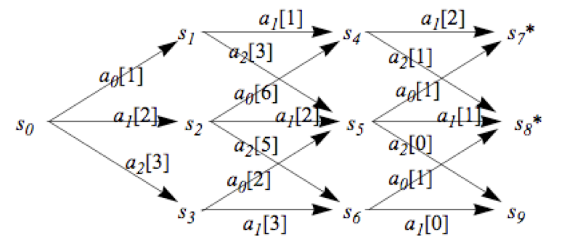
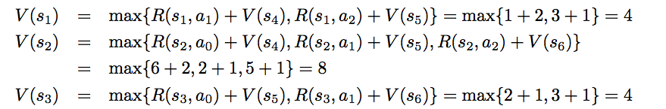
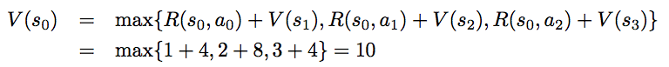
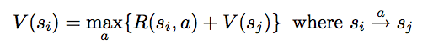
Compute State Values by Dynamic Programming (review, from ALFE 6.1.1)
Backward recursion: compute utility/values by backing from the goal* stage by stage
Rewards are given
a_{i}[R] = R(s,a_{i}) from
an action a_{i} on a state s
Backward recursion equation:

Slide 38
Markov Decision Process (MDP)
A MDP consists of
State S and actions A
Initial State s₀ Probability Distribution π
Transition Model Φ(s’|s,a)
Sensor Model θ(z|s)
A reward function R(s)
Note: A typical MDP has no sensor model

Slide 39
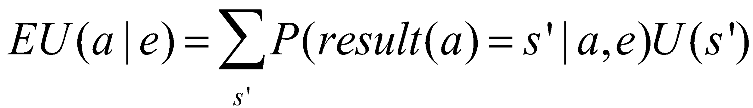
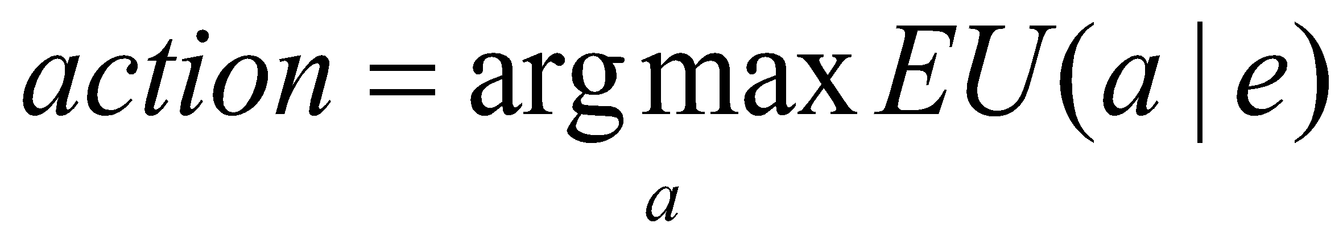
Maximum Expected Utility (MEU) and Rational Agents
Every state has a utility value U(s)
The expected utility of an action given the current evidence or observation e, is the average utility value of the outcomes, weighted by the probability that the outcome occurs:
The principle of maximum expected utility (MEU) is that a rational agent should choose the action that maximizes its expected utility:
s2
a₁
s9
U(s2)=0.4
a₂
U(s9)=0.2
s7
U(s7)=0.4

Slide 40
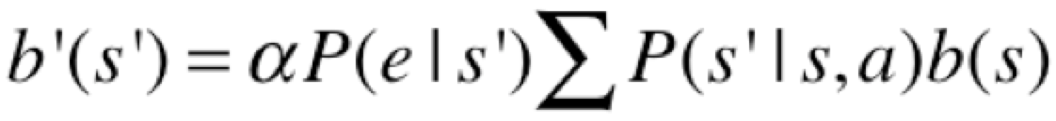
POMDP: Sensor Model, Belief States
A Partially Observable MDP (POMDP) is defined as follows:
A set of states S (with an initial state s₀)
A set of Actions: A(s) of actions in each state s
A transition model P(s’|s,a), or T(s,a,s’)
A reward function R(s), or R(s,a)
A sensor model P(e|s) 🡸 🡸
A belief of what the current state is b(s) 🡸 🡸
Belief States (where am I now? What is my current state?):
If b(s) was the previous belief state, and the robot does action “a” and then perceives a new evidence “e”, then the new belief state: where α is a normalization constant making the belief states sum to 1

Slide 41
Goals, Rewards, Utilities, Policies
Goals
Given to the agent from the problem statements
Rewards
Given to the agent, designed based on the goals
Utility values for states
Computed by the agent, based on the rewards
Policies
Computed or learned by the agent
Used by the agent to select its actions
The better a policy, the more rewards it collects

Slide 42
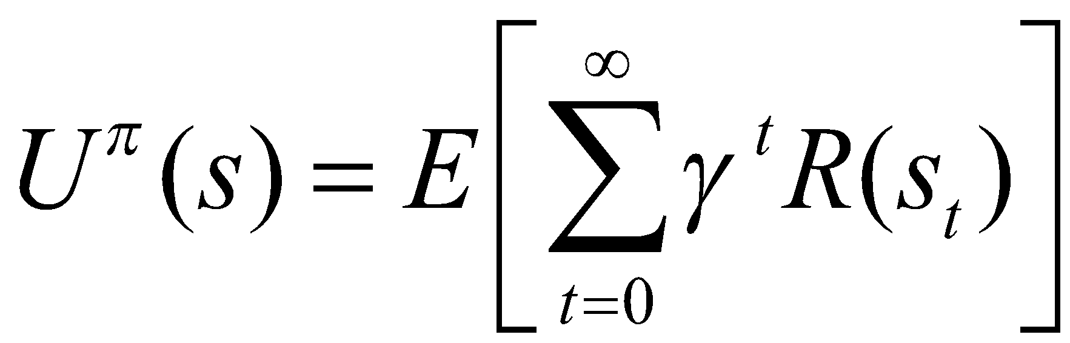
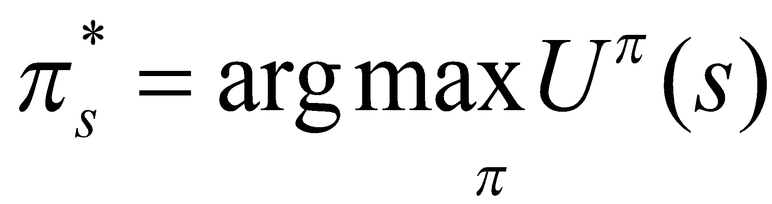
Compute Utilities from Rewards over Time
Utility Value = sum of all future rewards
Add the rewards as they are
Discount the far-away rewards in the future
The expected future utility value U^{π}(s) obtained by executing a policy π starting from s
The Optimal Policy

Slide 43
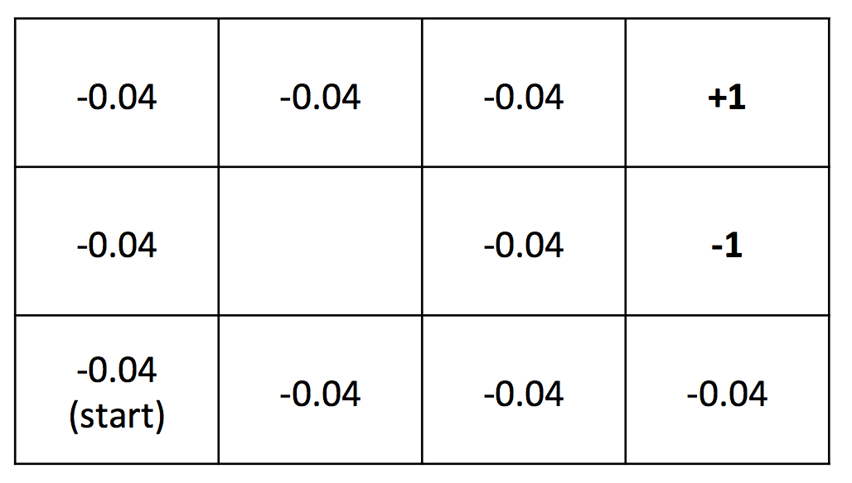
Compute Utilities (example)
0.812 | 0.868 | 0.918 | +1
0.762 |  | 0.660 | -1
0.705 | 0.655 | 0.611 | 0.388
Rewards (given)
Utilities (computed)
Given the rewards in all nonterminal state are R(s) = - 0.04,
Compute utilities using a future discount γ = 1
(we will see how these utilities are computed)

Slide 44
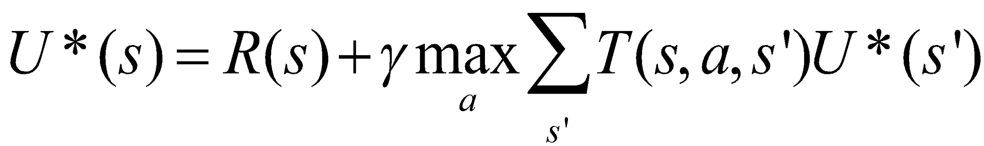
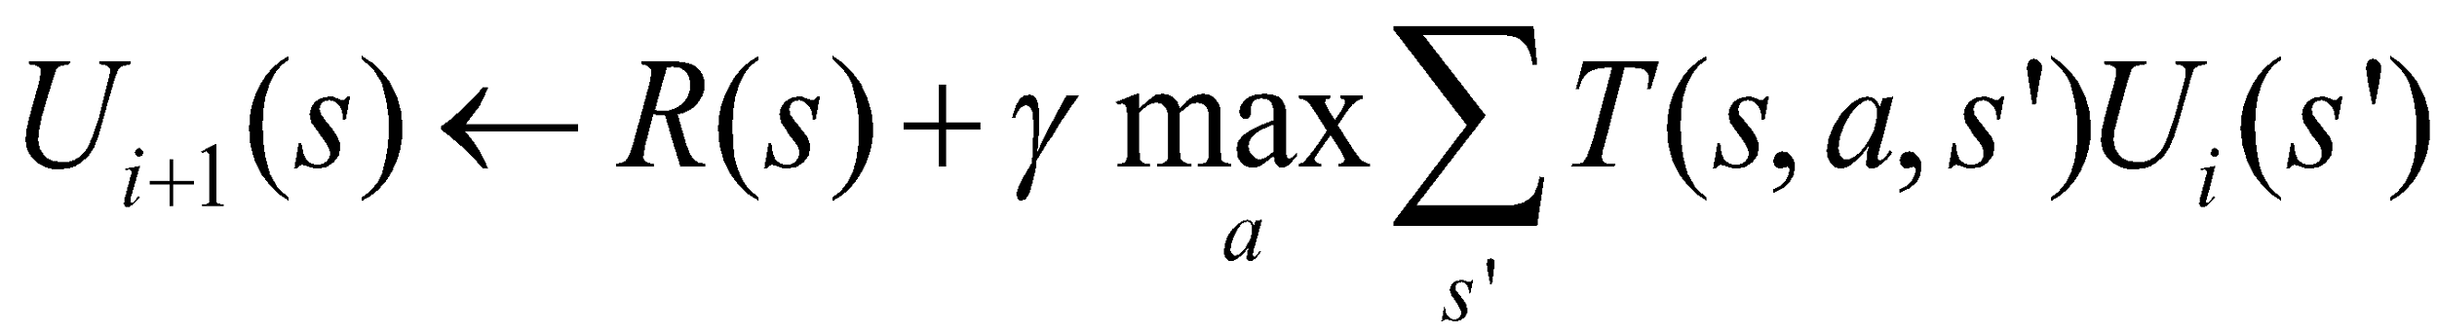
State Utility Value Iteration (improving U(s) every step)
U(s): the expected sum of maximum rewards achievable starting from a particular state s
Bellman equations:
For n states, there are n equations must be solved simultaneously
Bellman iteration:
Converge to U*(s) step by step
(17.5)
(17.6)

Slide 45
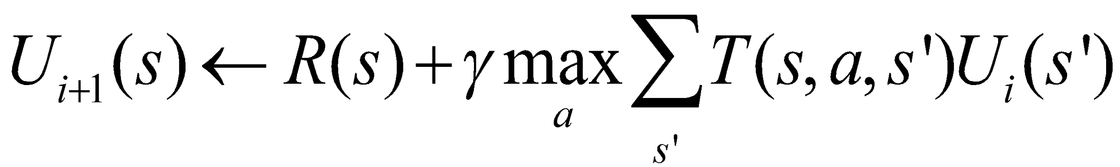
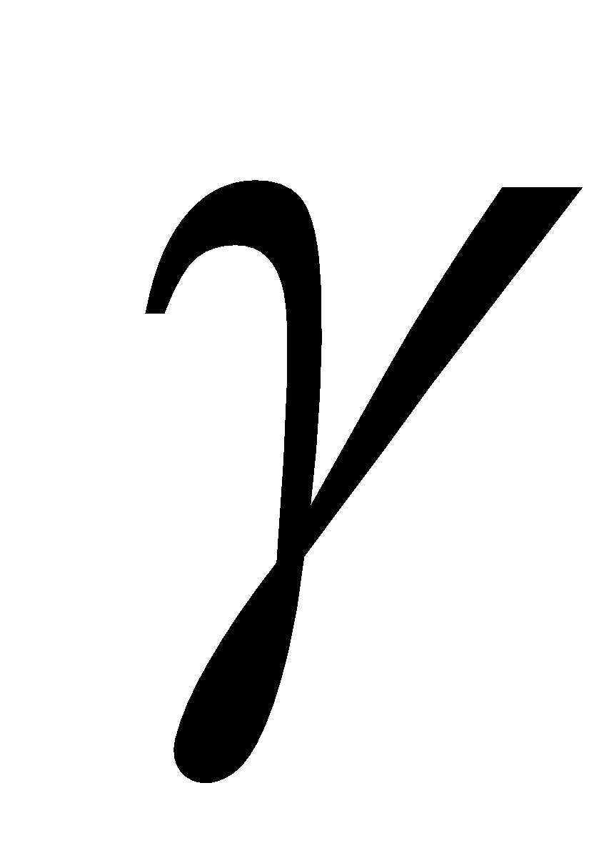
Bellman Iteration Example
The Initial Utility Values
Reward R(s)
0.0 | 0.0 | 0.0 | 0.0
0.0 |  | 0.0 | 0.0
0.0 | 0.0 | 0.0 | 0.0
-0.04 | -0.04 | -0.04 | +1
-0.04 |  | -0.04 | -1
-0.04 | -0.04 | -0.04 | -0.04
Transaction probability T(s, a, s’) = 0.8 for intended, 0.2 for sideways
Discount Gamma = 1.0
0.812 | 0.868 | 0.918 | +1
0.762 |  | 0.660 | -1
0.705 | 0.655 | 0.611 | 0.388
0.1
Intended
0.8
0.1
The Final Utility Values

Slide 46
Bellman Iteration Example (1st iteration)
The Initial Utilities U₀
Reward R(s)
0.0 | 0.0 | 0.0 | 0.0
0.0 |  | 0.0 | 0.0
0.0 | 0.0 | 0.0 | 0.0
-0.04 | -0.04 | -0.04 | +1
-0.04 |  | -0.04 | -1
-0.04 | -0.04 | -0.04 | -0.04
U₁(s₁) = -0.04 + 1.0*max(0.0*0.0)
U₁(s₄) = +1.0 + 1.0*max(0.0*0.0)
U₁(s₇) = -1.0 + 1.0*max(0.0*0.0)
Transaction probability T(s, a, s’) = 0.8 for intended, 0.2 for sideways
Discount Gamma = 1.0
-0.04 | -0.04 | -0.04 | +1.0
-0.04 |  | -0.04 | -1.0
-0.04 | -0.04 | -0.04 | -0.04
0.1
Intended
0.8
0.1
The Utility Values U₁ after 1st iteration

Slide 47
Bellman Iteration Example (2nd iteration)
U₁
-0.04 | -0.04 | -0.04 | +1.0
-0.04 |  | -0.04 | -1.0
-0.04 | -0.04 | -0.04 | -0.04
Reward R(s)
-0.04 | -0.04 | -0.04 | +1
-0.04 |  | -0.04 | -1
-0.04 | -0.04 | -0.04 | -0.04
U₂(s₄) = +1.0 + 1.0*max(0, 0, 0)
U₂(s₇) = -1.0 + 1.0*max(0, 0, 0)
U₂(s₃) = -.04 + 1.0*max(.8*1-.1*.04-.1*.04, …)
U₂(s₆) = -.04 + 1.0*max(-.8*.04-.1*.04-.1*.04,…)
Transaction probability T(s, a, s’) = 0.8 for intended, 0.2 for sideways
Discount Gamma = 1.0
U₂
? | ? | 0.752 | +1.0
? |  | -0.08 | -1.0
? | ? | ? | ?
0.1
Intended
0.8
The Utility Values U₂ after 2nd iteration
Please fill in the values for “?”
0.1

Slide 48
Bellman Iteration Example
The Initial Utilities
Reward R(s)
0.0 | 0.0 | 0.0 | 0.0
0.0 |  | 0.0 | 0.0
0.0 | 0.0 | 0.0 | 0.0
-0.04 | -0.04 | -0.04 | +1
-0.04 |  | -0.04 | -1
-0.04 | -0.04 | -0.04 | -0.04
Transaction probability T(s, a, s’) = 0.8 for intended, 0.2 for sideways
Discount Gamma = 1.0
0.812 | 0.868 | 0.918 | +1
0.762 |  | 0.660 | -1
0.705 | 0.655 | 0.611 | 0.388
0.1
Intended
0.8
0.1
Please verify these final Utility Values by yourself!!

Slide 49
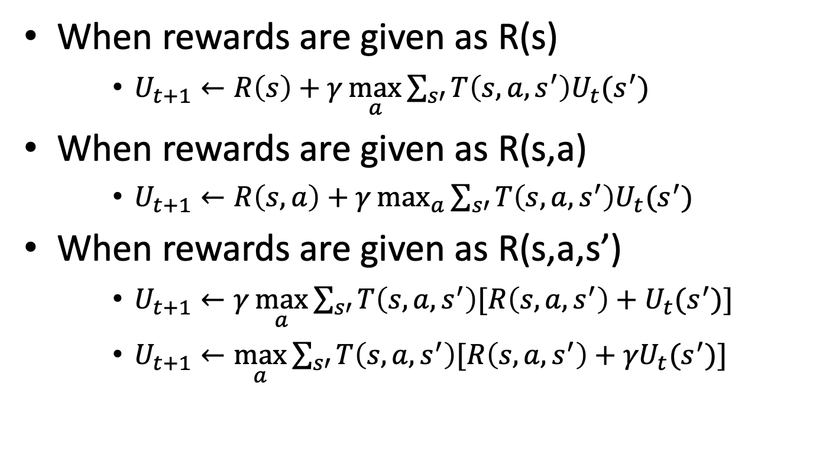
Utility Value Iteration (3 types of rewards)

Slide 50
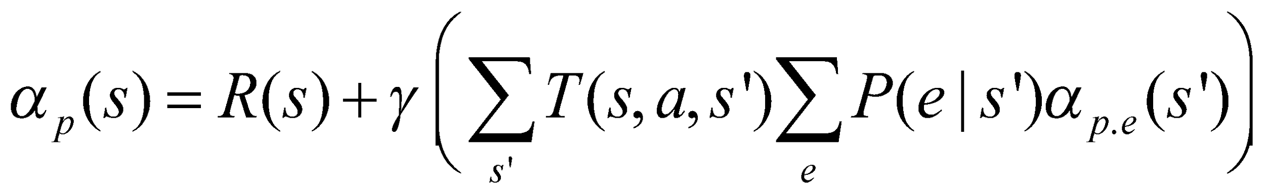
Utility Value Iteration for POMDP
In MDP, utility value iteration, when sensors are certain, we know the next state s’
In POMDP, where sensors are uncertain, we must average over all possible evidences for the next state s’ (see the last term below):

Slide 51
Policy and Optimal Policy
A solution of (PO)MDP can be represented as
A Policy π(s)=a
Each execution of policy from s₀ may yield a different history or path due to the probabilistic nature of the transition model
An optimal policy π*(s) is a policy that yields the highest expected utility

Slide 52
Policy Based on Known Utility Values
0.812 | 0.868 | 0.918 | +1
0.762 |  | 0.660 | -1
0.705 | 0.655 | 0.611 | 0.388
Suppose we know the utility values of the states as above,
What path would an optimal policy would choose?
Rewards -> Utility Values -> Policies

Slide 53
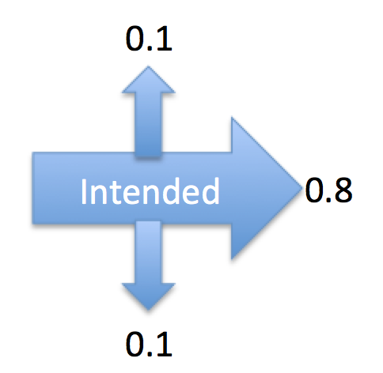
Optimal Policy Examples Depending on Reward distribution R(s)
If the rewards for the nonterminal states are evenly distributed (e.g., -0.04), then the path chosen will depend on the probabilities of the transition model
-> | -> | -> | +1
^ |  | ^ | -1
^ | <- | ^ | <-
3
Nonterminal R(s)= - 0.04
2
1
1
2
3
4
Caution: because the nondeterministic actions, from state (3,2) or (4,1),
you may “accidentally” go to (4,2). So there is a “risk” in this policy.

Slide 54
Optimal Policy Examples Depending on the reward distribution R(s)
> | > | > | +1
^ |  | > | -1
^ | > | > | ^
> | > | > | +1
^ |  | ^ | -1
^ | > | ^ | <
Nonterminal rewards R(s)=-0.04
suicide
risky
> | > | > | +1
^ |  | ^ | -1
^ | < | < | <
suicide
R(s)<-1.6284
(life is painful, death is better)
-0.4278 < R(s)<-0.0850
(life is OK, willing to risk)
> | > | > | +1
^ |  | < | -1
^ | < | < | <
❖ | ❖ | < | +1
❖ |  | < | -1
❖ | ❖ | ❖ | V
end nicely
don’t end
?
Why not go up?
no risk
no risk
risky
no risk
Hint: Consider the nature of actions, deterministic or not
Go up is “risky”
-0.0221<R(s)<0
(life is good, minimize risks, willing to end nicely)
R(s)>0
(life is rewarding,
I don’t want to end it)

Slide 55
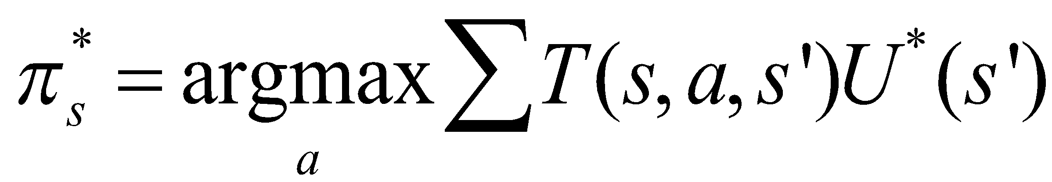
Optimal Policy
You can compute the optimal policy once after all U*(s) are known
Or, you can compute it incrementally every iteration when U_{i}(s) is updated
This is called “Policy Iteration” (see the next slide)

Slide 56
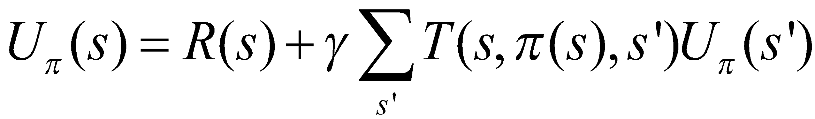
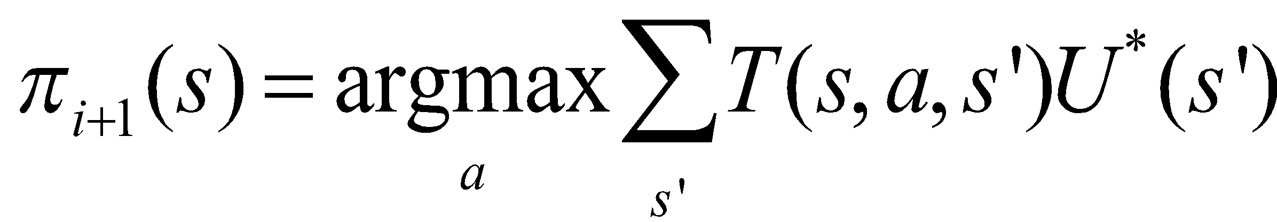
Policy Iteration (improving π(s) every step)
Start with a randomly chosen initial policy π₀
Iterate until no change in utility values of the state:
Policy evaluation: given a policy π_{i}, calculate the utility U_{i}(s) of every state s using policy π_{i} by solving the system of equations:
Policy improvement: calculate the new policy π_{i+1} using one‐step look‐ahead based on the current U_{i}(s):

Slide 57
Policy Iteration Comments
Each step of policy iteration is guaranteed to strictly improve the policy at some state when improvement of state utility value is possible
Converge to the optimal policy
Gives the exact value of the optimal policy

Slide 58
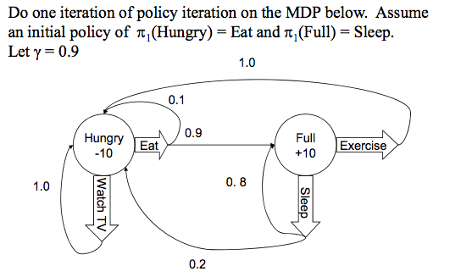
Policy Iteration Example

Slide 59
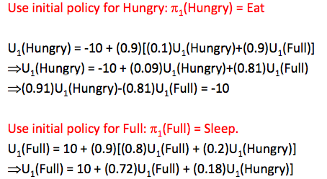
Policy Iteration Example

Slide 60
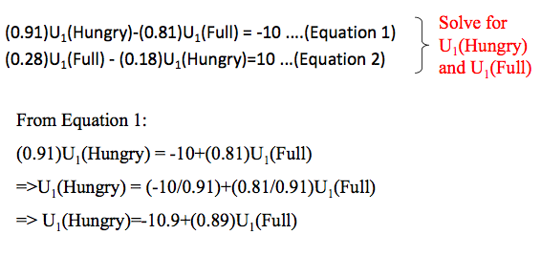
Policy Iteration Example

Slide 61
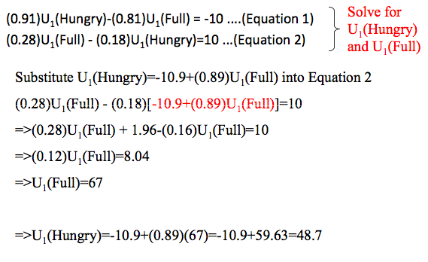
Policy Iteration Example

Slide 62
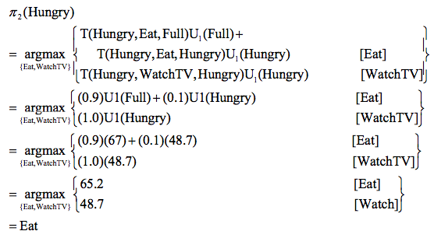
Policy Iteration Example

Slide 63
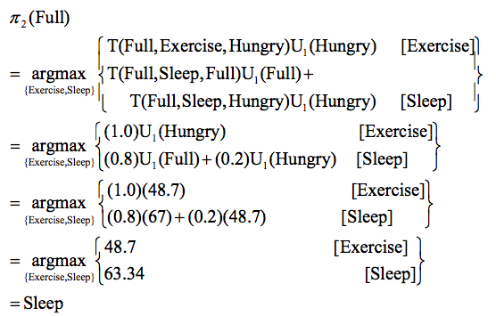
Policy Iteration Example

Slide 64
Policy Iteration Example
The new policy π₂ after an iteration from π₁
π₂(Hungry)->Eat
π₂(Full)->Sleep

Slide 65
Summary for Uncertain Environments
POMDP is very (the most) general model
Deal with uncertainty by
action models and sensor models
Incorporate goals -> rewards -> utilities -> policy
Utilities and policies can be computed from rewards
Systematically (Bellman equations)
Iteratively (Bellman’s iteration algorithm)
Solve a problem by following a good policy
One policy for one problem/goal
Different policies are needed for different goals

Slide 66
REINFORCEMENT LEARNING

Slide 67
Markov Decision Process
Markov Decision Process
We learned that a Markov Decision Process (MDP) consists of
A set of states S (with an initial state s₀)
A set of actions A in each state,
A set of percepts that can be sensed
A transition model P(s’|s,a), or T(s,a,s’)
A sensor model θ = P(z|s)
The current state distribution
A reward function R(s,a,s’) // careful here
The MDP’s solution identifies the best action to take in each state
Optimal policy π(s)=a obtained by value iteration or policy iteration (aka dynamic programming)

Slide 68
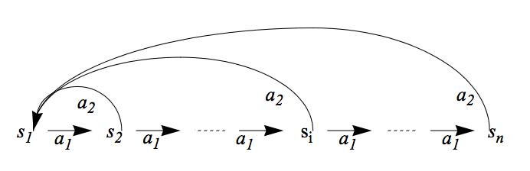
An Example for MDP
Given
States: s₁, …, s_{n,} Actions: a₁, a₂
Transition Probability Distribution: (assume s_{n+1}=s₁)
P(s_{i},a₁,s_{i+1})=0.8, P(s_{i},a₁,s₁)=0.2, P(s_{i},a₂,s₁)=0.9, P(s_{i},a₂,s_{i+1})=0.1.
Reward: all R(s_{i}, a_{i}, s_{j}) = 0.0, except R(s_{n-1}, a₁, s_{n}) = 99.9
We define the goal state to be s_{n}
The Future discount factor: gamma γ = 0.7
State utility values: U(s_{n-1}), U(s_{n-2}), U(s_{n-3}), … and U(s₂), U(s₁)
Optimal Policy: π(s_{i})=a₁
99.9
Goal

Slide 69
Reinforcement Learning
Given a Markov Decision Process (environment)
A set of states S ✔ (known)
A set of actions A in each state ✔ (known)
A set of percepts that can be sensed ✔ (known)
The current state ✔ (known)
Transitions P(s’| s, a) ✖ (only known by the env)
Rewards R(s, a, s’) ✖ (only known by the env)
Could the agent still learn the optimal policy?

Slide 70
Goals, Rewards, Utilities, Policies
Goals
Given to the agent from the problem statements
Rewards
Given to the agent, designed based on the goals
Utility values for states
Computed by the agent, based on the rewards
Policies
Computed or learned by the agent
Used by the agent to select its actions
The better a policy, the more rewards it collects

Slide 71
Reinforcement Learning Propagating the Delayed Rewards
G
G
Before RL
After RL
After RL, no matter where you are, you know which way to go to the Goal!
This is because all states now have utility values that will lead your agent to the goal.

Slide 72
Reinforcement Learning (Key Ideas)
Can the agent still learn the optimal policy?
When it knows only the states S and actions A, but not the transition model P(s,a,s’) and/or reward function R(s,a,s’)
Try an action on a state of the environment, and get a “sample” that includes (s, a, s’, r) and maybe U:
A state transition (s,a)->s’
A reward received for the action r = R(s, a, s’)
And maybe the utility value of the next state U(s’)
Objective: Try different actions in states to discover an optimal policy π(s)=a and eventually tells the agent which action will lead to the most rewarding states

Slide 73
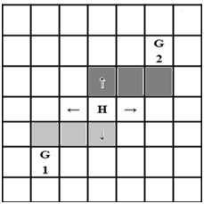
How to Explore the State Space
Visit different states to discover a policy and improve it
Numerous strategies
A simple strategy is executing actions randomly
Initially there is no policy, but random actions eventually discover a policy
At every time step, act randomly with a probability (for exploration), otherwise, follow the current policy π(s)=a
The random action may causes unnecessary action execution when the optimal policy is already discovered
One solution is to lower the probability of selecting a random action over time (i.e., reduce the “temperature”)

Slide 74
Reinforcement Learning
Objective: Learn the optimal policy π*(s)=a
Two general classes of algorithms:
Model-based RL
First learn the transition model and the utility values of states, then learn the policy (e.g., policy iteration)
Model-free RL
Learn the policy without learning an explicit transition model, but by receiving “samples” from the environment
Three algorithms we will learn:
Monte Carlo
Temporal Difference
Q-Learning

Slide 75
An Example for Model-Based RL
Given
States: s₁, …, s_{n,}
Actions: a₁, a₂
Probabilistic transition model: (assume s_{n+1}=s₁)
P(s_{i},a₁,s_{i+1})=0.8, P(s_{i},a₁,s₁)=0.2, P(s_{i},a₂,s₁)=0.9, P(s_{i},a₂,s_{i+1})=0.1.
Reward: all R(s_{i}, a_{i}, s_{j}) = 0.0, except R(s_{n-1}, a₁, s_{n}) = 99.9
Future discount factor: γ = 0.7
Try to learn: U(s_{n-1}), U(s_{n-2}), U(s_{n-3}), … and U(s₂), U(s₁)
99.9

Slide 76
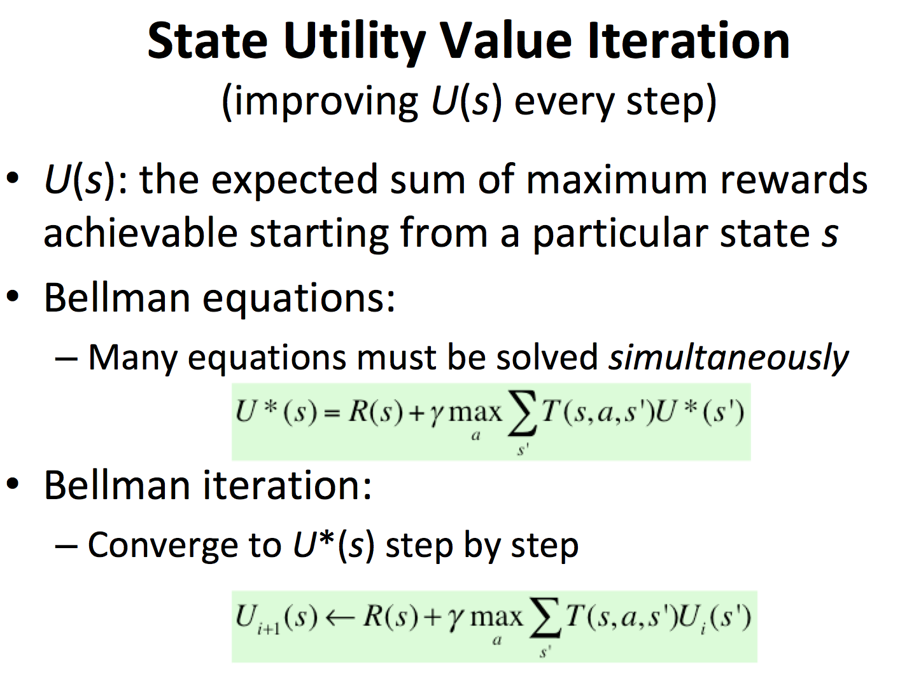
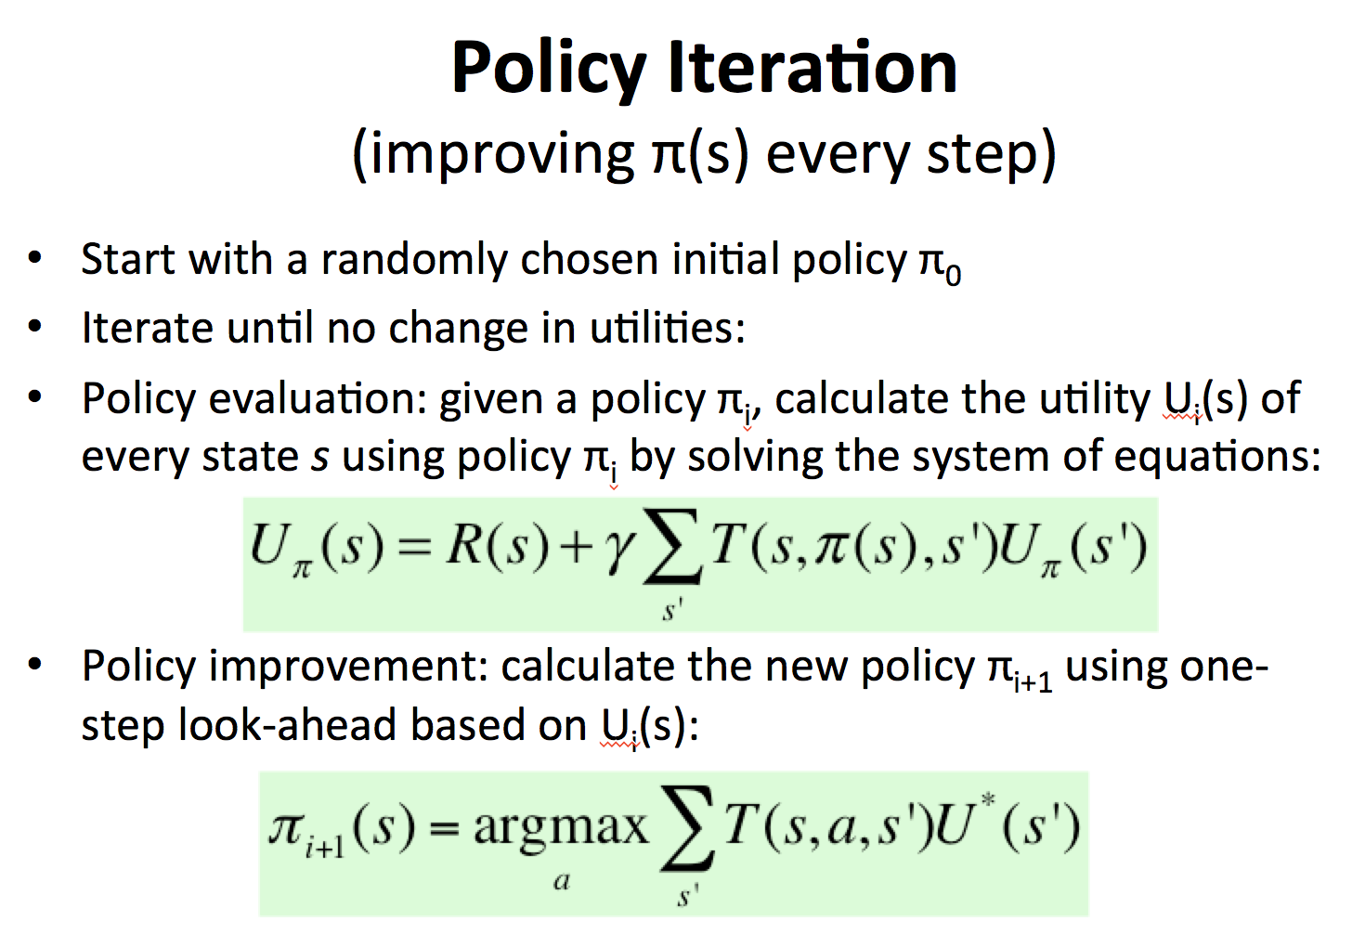
Model-Based RL
Learn an approximate model based on random actions
From a state s, count outcomes of s’ for each (s, a)
Normalize to give an estimate of P(s, a, s’)
Learn state utility U(s) from rewards R(s, a, s’) when encountered
Learn a policy (e.g., policy iteration) and solve the MDP

Slide 77
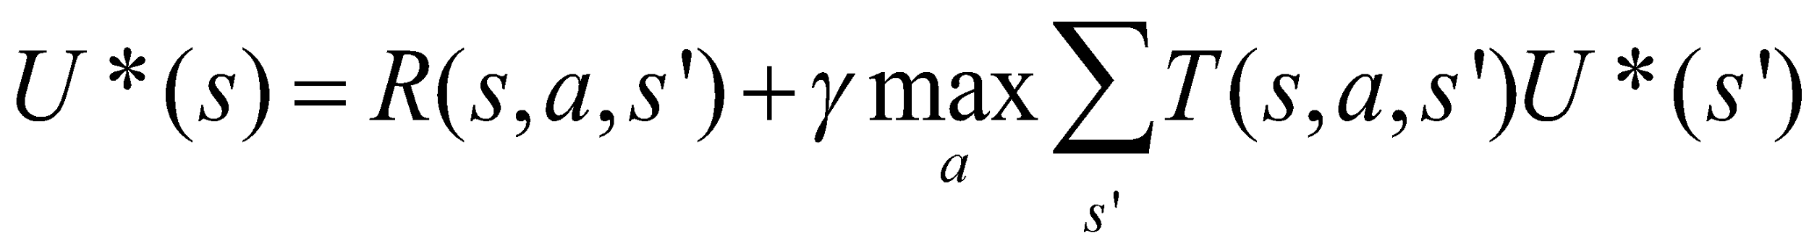
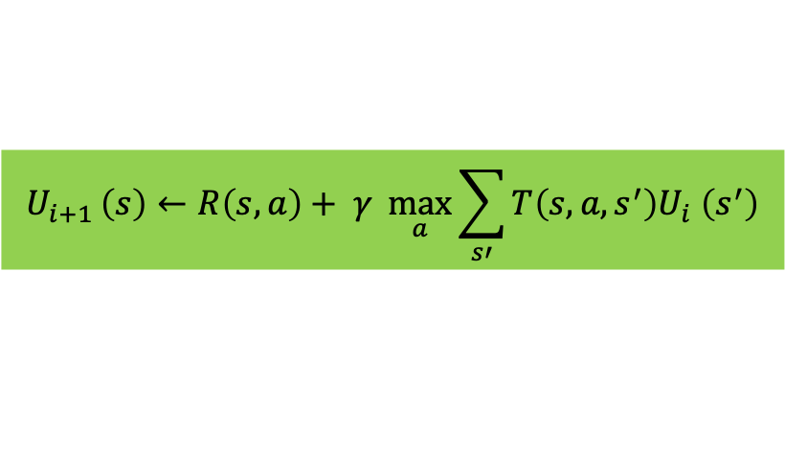
State Utility Value Iteration (review) (improving U(s) every step)
U(s): the expected sum of maximum rewards achievable starting from a particular state s
Bellman equations:
Many equations must be solved simultaneously
Bellman iteration:
Converge to U*(s) step by step

Slide 78
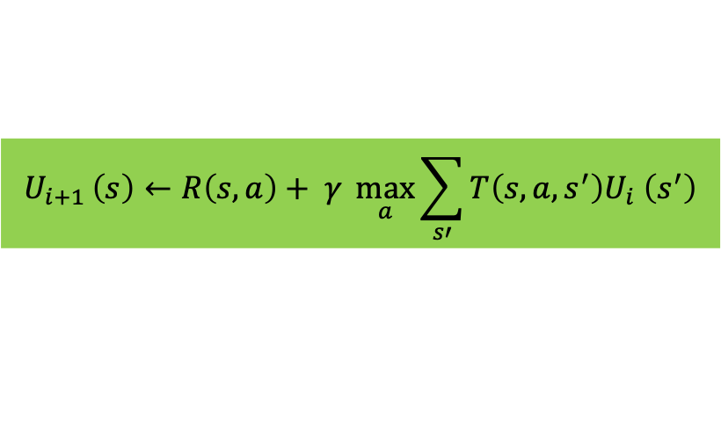
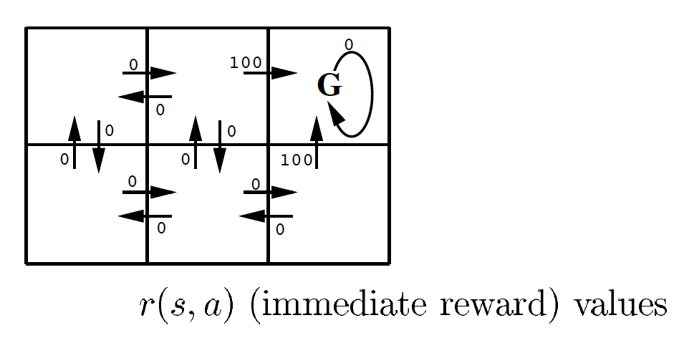
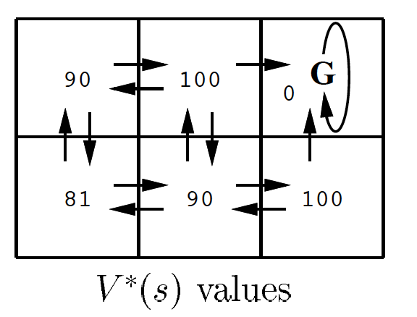
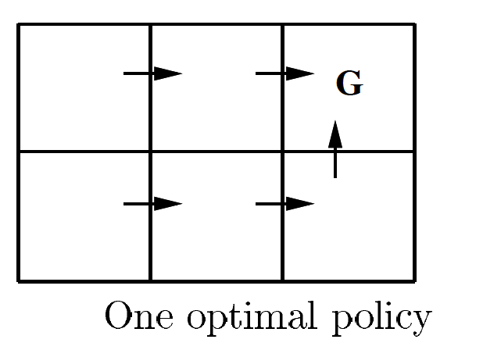

Utility Value Iteration (example)
Find your way to the goal
Use Bellman Iteration to compute state values from rewards
γ=0.9

Slide 79

Policy Iteration (review) (improving π(s) every step)
Start with a randomly chosen initial policy π₀
Iterate until no change in the utility values of the states:
Policy evaluation: given a policy π_{i}, calculate the utility value U_{i}(s) of every state s using policy π_{i} by solving the system of equations:
Policy improvement: calculate the new policy π_{i+1} using one‐step look‐ahead based on U_{i}(s):

Slide 80

Compute Utility from Rewards and Policy
Transition: P(y|x,a), or P_{xy}[a]
y₁
V(y₁)
Assume the transitions are known
V(x)
Rewards:
R(x,a₁)
x
y₂
V(y₂)
a₁
Policy: a₁=π(x)
y_{l}
V(y_{j})

Slide 81


An Example for Model-Based RL
Given
States: s₁, …, s_{n} Actions: a₁, a₂
Probabilistic transition model: (assume s_{n+1}=s₁)
P(s_{i},a₁,s_{i+1})=0.8, P(s_{i},a₁,s₁)=0.2, P(s_{i},a₂,s₁)=0.9, P(s_{i},a₂,s_{i+1})=0.1.
Reward: all R(s_{i}, a_{i}, s_{j}) = 0.0, except R(s_{n-1}, a₁, s_{n}) = 99.9
Future discount factor: γ = 0.7, all Initial utility values are: U(s_{i-})=0
1st iteration
U(s_{n-1})=0.7max{0.8(99.9+0)+0.2(0+0), …, …} = 55.944; or
U(s_{n-1})=max{0.8(99.9+0.7*0)+0.2(0+0), …, …} = 79.92;
U(s_{n-2})=0, U(s_{n-3})=0, …, U(s₁)=0
After many iterations: U(s₁) = ? Is it 99.9*(0.7*0.8)^{n-1} ?
99.9

Slide 82
Model-Based RL
Learn an approximate model based on random actions
From a state s, count outcomes of s’ for each (s, a)
Normalize to give an estimate of P(s, a, s’)
Learn state utility U(s) from rewards R(s, a, s’) when encountered
Solve the learned MDP and obtain a policy (e.g. policy iteration)
Pros:
If and when the goal changes, one can use the learned model P(s, a, s’) to recalculate U(s) and compute a new policy offline
Cons:
Larger representation than model-free RL

Slide 83
Model-Free Reinforcement Learning
Objective: Learn the optimal policy π*(s)=a
Model-based RL
First learn the transition model and the utility values of states, then learn the policy (e.g., policy iteration)
Model-free RL
Learn the policy without learning an explicit model, but by receiving “samples” from the environment
Three algorithms we will learn:
Monte Carlo
Temporal Difference
Q-Learning

Slide 84
Monte Carlo RL (model free)
Generate a fixed policy π(s) = a based on U(s)
In each episode, the learner follows the policy starting at a random state
Average the sampled returns originating from each state
Generate a policy based on U(s) as in “policy iteration”
Cons:
The utility value of states U(s) is given and fixed (not learned)
Works only in episodic problems
Takes a very long time to converge as learning is from complete sample returns
Wastes information as it figures out state values in isolation from other states

Slide 85
Temporal Difference RL (model free)
Improve Monte Carlo, still using a fixed policy
Update U(s) using each sample (s, a, s’, r) received from the environment and each sample includes:
A state transition (s,a)->s’ done by the environment
A reward received for the action r = R(s, a, s’)
And the value of the next state U(s’)
That is, Sample = r + γU(s’), where γ = future discount
TD Algorithm:
U(s) ← (1-α)U(s) + α*Sample = (1-α)U(s) + α[r + γU(s’)]
Where α is the “learning rate” (how much you trust the sample)
You might decrease α over time when converges to the average
The parameter α also represents “forgetting long past values”
Cons:
Only provides the utility values of states, not improve policy directly

Slide 86
An Example for TD-RL
Given
States: s₁, …, s_{n,}
Actions: a₁, a₂
Probabilistic transition model: (assume s_{n+1}=s₁)
P(s_{i},a₁,s_{i+1})=0.8, P(s_{i},a₁,s₁)=0.2, P(s_{i},a₂,s₁)=0.9, P(s_{i},a₂,s_{i+1})=0.1.
Reward: all R(s_{i}, a_{i}, s_{j}) = 0.0, except R(s_{n-1}, a₁, s_{n}) = 99.9
We define the goal state to be s_{n}
The learning rate α = 0.4
The Future discount factor: γ = 0.7
Use TD algorithm to learn: U(s_{n-1}), U(s_{n-2}), U(s_{n-3}), … and U(s₂), U(s₁)
99.9

Slide 87


Q-Learning (Definition)
The key idea is to use Q(s,a) to represent the value of taking an action a in state s, rather than only the value of state U(s):
Define:
Optimal π(s) = argmax U^{π} (s) = argmax_{a} Q(s, a)
The last term using Q to replace U

Slide 88
Q-Learning (Algorithm)
Initially, let Q(s, a)=0, given α and γ
Sample a transition and reward: (s,a,s’,r)
Sample = r + γ max_{a’} Q(s’,a’)
Q(s,a) = (1-α)Q(s,a) + α*Sample
r
a’
S’
s
a
Advantages:
No need for a fixed policy, can do off-policy learning, or directly learns a policy
The optimal policy π(s)=a is to select the action a that has the best Q(s, a)
Provably convergent to the optimal policy when t -> infinite

Slide 89

The Q-Learning Algorithm

Slide 90

Q-Learning (in One Formula)
r(s) or r(s,a)

Slide 91


Q-Learning example from reward r(s,a)
Q-values
Reward(s₁,right)=72
72
72+
γ=0.9
// when α = 1
72+
72+
Back-propagate Q-values 1-step backwards

Slide 92


Q-Learning from state utility values
Q-Learning
Notice these

Slide 93
An Example for Q-Learning
Given
States: s₁, …, s_{n,}
Actions: a₁, a₂
Probabilistic transition model: (assume s_{n+1}=s₁)
P(s_{i},a₁,s_{i+1})=0.8, P(s_{i},a₁,s₁)=0.2, P(s_{i},a₂,s₁)=0.9, P(s_{i},a₂,s_{i+1})=0.1.
Reward: all R(s_{i}, a_{i}, s_{j}) = 0.0, except R(s_{n-1}, a₁, s_{n}) = 99.9
We define the goal state to be s_{n}
The learning rate α = 0.4
The Future discount factor: γ = 0.7
Try to learn: Q(s_{n-1},a₁), Q(s_{n-1},a₂), Q(s_{n-2},a₁), and Q(s_{n-2},a₂)=?
99.9

Slide 94
An Example for Q-Learning
Initially: all Q(s_{i}, a_{j}) = 0.0
Assume you got two samples at the state s_{n-1} for action a₁
s_{n-1},a₁, s_{n}, r=R(s_{n-1},a₁, s_{n})=99.9, // P(s_{n-1},a₁)->🡪s_{n}
s_{n-1},a₁, s₁, r=R(s_{n-1},a₁, s₁)=0.0, // P(s_{n-1},a₁)->🡪s₁
Updated Q value, if P(s,a) are known:
Q(s_{n-1},a₁)= 0.8*[99.9 + 0.7*0.0] + 0.2[0.0+0.7*0.0] = 79.9
If P(s,a) are unknown, assume s_{n-1} was visited 2 times so far:
sample₁=99.9+.7*0; Q(s_{n-1},a₁)= (1-0.4)*0.0 + 0.4*99.9 = 39.96
sample₂=0+.7*0; Q(s_{n-1},a₁)= (1-0.4)*39.96 + 0.4*0.0 = 23.976
99.9

Slide 95
Discussions of RL (1)
Pros:
Easy to use in problems where the data can be mapped to states easily
Guaranteed to find the optimal policy given enough time even with suboptimal actions
Cons:
States of the environment are not always known
Computation time is intractable for large or continuous state spaces
E.g. if each cell in a grid world is a state, then state space grows exponentially with number of rows and columns (states = map size = m*n)
Cannot handle raw data, must use an approximation/reduction function
Designing approximation functions to disambiguate similar states requires human intelligence or an alternate learning technique
E.g. use the relative distance (states = m*n) between two agents in a hunter-prey problem as opposed to their cell coordinates (states = m*n*m*n)
Model-free RL cannot transfer the learned knowledge when the goal changes
Forgetting a learned policy is much more difficult (hysteresis), quicker to start from scratch

Slide 96
Discussions of RL (2)
Utility function is unknown at the beginning
When agent visits each state, it receives a reward
Possibly negative
What function should it learn?
R(s): Utility-based agent
If it already knows the transition model
Then use MDP algorithm to solve for MEU actions
U(s,a): Q-learning agent
If it doesn’t already know the transition model
Then pick action that has highest U in current state
𝜋*(s): reflex agent
Learn a policy directly, then pick the action that the policy says

Slide 97
Q Learning Summary
Modify Bellman equation to learn Q values of actions
U(s) = R(s)+𝛾max_{a}∑_{s1}(P(s₁|s,a)U(s₁))
We don’t know R or P
But when we perform a’ in s, we move to s’ and receive R(s)
We want Q(s,a) = Expected utility of performing a in state s
Update Q after each step
If we get a good reward now, then increase Q
If we later get to a state with high Q, then increase Q here too
Q(s,a)← (1-⍺)Q(s,a) + ⍺(R(s)+𝛾 max_{a’}Q(s’,a’))
⍺ is the learning rate, 𝛾 is the discount factor
Converges to correct values if ⍺ decays over time
Similar to the “temperature” in simulated annealing

Slide 98
Q-Learning in Star War Environment
1 | 2 | 3 | 4
5 |  | 6 | 7
8 | 9 | 10 | 11

Slide 99
Initial Q Values
⍺ = 0.1 𝛾 = 1
U: 0.0
D: 0.0
L: 0.0
R: 0.0
U: 0.0
D: 0.0
L: 0.0
R: 0.0
U: 0.0
D: 0.0
L: 0.0
R: 0.0
U: 0.0
D: 0.0
L: 0.0
R: 0.0
1 | 2 | 3 | 4
5 |  | 6 | 7
8 | 9 | 10 | 11
U: 0.0
D: 0.0
L: 0.0
R: 0.0
U: 0.0
D: 0.0
L: 0.0
R: 0.0
U: 0.0
D: 0.0
L: 0.0
R: 0.0
U: 0.0
D: 0.0
L: 0.0
R: 0.0
U: 0.0
D: 0.0
L: 0.0
R: 0.0
U: 0.0
D: 0.0
L: 0.0
R: 0.0
U: 0.0
D: 0.0
L: 0.0
R: 0.0

Slide 100
Step 1
Q(s,a)← (1−⍺)Q(s,a) + ⍺(R(s)+𝛾 max_{a’}Q(s’,a’))
U: 0.0
D: 0.0
L: 0.0
R: 0.0
U: 0.0
D: 0.0
L: 0.0
R: 0.0
U: 0.0
D: 0.0
L: 0.0
R: 0.0
U: 0.0
D: 0.0
L: 0.0
R: 0.0
1 | 2 | 3 | 4
5 |  | 6 | 7
8 | 9 | 10 | 11
U: 0.0
D: 0.0
L: 0.0
R: 0.0
U: 0.0
D: 0.0
L: 0.0
R: 0.0
U: 0.0
D: 0.0
L: 0.0
R: 0.0
U: 0.0
D: 0.0
L: 0.0
R: 0.0
U: 0.0
D: 0.0
L: 0.0
R: 0.0
U: 0.0
D: 0.0
L: 0.0
R: 0.0
U: 0.0
D: 0.0
L: 0.0
R: 0.0

Slide 101
Step 1
Q(1,R)← (1−⍺)Q(1,R) + ⍺(R(1)+𝛾 max_{a’}Q(2,a’))
U: 0.0
D: 0.0
L: 0.0
R: 0.0
U: 0.0
D: 0.0
L: 0.0
R: 0.0
U: 0.0
D: 0.0
L: 0.0
R: 0.0
U: 0.0
D: 0.0
L: 0.0
R: 0.0
1 | 2 | 3 | 4
5 |  | 6 | 7
8 | 9 | 10 | 11
U: 0.0
D: 0.0
L: 0.0
R: 0.0
U: 0.0
D: 0.0
L: 0.0
R: 0.0
U: 0.0
D: 0.0
L: 0.0
R: 0.0
U: 0.0
D: 0.0
L: 0.0
R: 0.0
U: 0.0
D: 0.0
L: 0.0
R: 0.0
U: 0.0
D: 0.0
L: 0.0
R: 0.0
U: 0.0
D: 0.0
L: 0.0
R: 0.0

Slide 102
Step 1
Q(1,R)← (1−⍺)Q(1,R) + ⍺(−0.04+𝛾 max_{a’}Q(2,a’))
U: 0.0
D: 0.0
L: 0.0
R: 0.0
U: 0.0
D: 0.0
L: 0.0
R: 0.0
U: 0.0
D: 0.0
L: 0.0
R: 0.0
U: 0.0
D: 0.0
L: 0.0
R: 0.0
1 | 2 | 3 | 4
5 |  | 6 | 7
8 | 9 | 10 | 11
U: 0.0
D: 0.0
L: 0.0
R: 0.0
U: 0.0
D: 0.0
L: 0.0
R: 0.0
U: 0.0
D: 0.0
L: 0.0
R: 0.0
U: 0.0
D: 0.0
L: 0.0
R: 0.0
U: 0.0
D: 0.0
L: 0.0
R: 0.0
U: 0.0
D: 0.0
L: 0.0
R: 0.0
U: 0.0
D: 0.0
L: 0.0
R: 0.0

Slide 103
Step 1
Q(1,R)← (1−⍺)Q(1,R) + ⍺(−0.04+𝛾 0.0)
U: 0.0
D: 0.0
L: 0.0
R: 0.0
U: 0.0
D: 0.0
L: 0.0
R: 0.0
U: 0.0
D: 0.0
L: 0.0
R: 0.0
U: 0.0
D: 0.0
L: 0.0
R: 0.0
1 | 2 | 3 | 4
5 |  | 6 | 7
8 | 9 | 10 | 11
U: 0.0
D: 0.0
L: 0.0
R: 0.0
U: 0.0
D: 0.0
L: 0.0
R: 0.0
U: 0.0
D: 0.0
L: 0.0
R: 0.0
U: 0.0
D: 0.0
L: 0.0
R: 0.0
U: 0.0
D: 0.0
L: 0.0
R: 0.0
U: 0.0
D: 0.0
L: 0.0
R: 0.0
U: 0.0
D: 0.0
L: 0.0
R: 0.0

Slide 104
Step 1
Q(1,R)← (1−⍺)0.0 + ⍺(−0.04+𝛾 0.0)
U: 0.0
D: 0.0
L: 0.0
R: 0.0
U: 0.0
D: 0.0
L: 0.0
R: 0.0
U: 0.0
D: 0.0
L: 0.0
R: 0.0
U: 0.0
D: 0.0
L: 0.0
R: 0.0
1 | 2 | 3 | 4
5 |  | 6 | 7
8 | 9 | 10 | 11
U: 0.0
D: 0.0
L: 0.0
R: 0.0
U: 0.0
D: 0.0
L: 0.0
R: 0.0
U: 0.0
D: 0.0
L: 0.0
R: 0.0
U: 0.0
D: 0.0
L: 0.0
R: 0.0
U: 0.0
D: 0.0
L: 0.0
R: 0.0
U: 0.0
D: 0.0
L: 0.0
R: 0.0
U: 0.0
D: 0.0
L: 0.0
R: 0.0

Slide 105
Step 1
Q(1,R)← 0.1(−0.04+0.0)
U: 0.0
D: 0.0
L: 0.0
R: 0.0
U: 0.0
D: 0.0
L: 0.0
R: 0.0
U: 0.0
D: 0.0
L: 0.0
R: 0.0
U: 0.0
D: 0.0
L: 0.0
R: 0.0
1 | 2 | 3 | 4
5 |  | 6 | 7
8 | 9 | 10 | 11
U: 0.0
D: 0.0
L: 0.0
R: 0.0
U: 0.0
D: 0.0
L: 0.0
R: 0.0
U: 0.0
D: 0.0
L: 0.0
R: 0.0
U: 0.0
D: 0.0
L: 0.0
R: 0.0
U: 0.0
D: 0.0
L: 0.0
R: 0.0
U: 0.0
D: 0.0
L: 0.0
R: 0.0
U: 0.0
D: 0.0
L: 0.0
R: 0.0

Slide 106
Step 1
Q(1,R)← −0.004
U: 0.0
D: 0.0
L: 0.0
R: -0.004
U: 0.0
D: 0.0
L: 0.0
R: 0.0
U: 0.0
D: 0.0
L: 0.0
R: 0.0
U: 0.0
D: 0.0
L: 0.0
R: 0.0
1 | 2 | 3 | 4
5 |  | 6 | 7
8 | 9 | 10 | 11
U: 0.0
D: 0.0
L: 0.0
R: 0.0
U: 0.0
D: 0.0
L: 0.0
R: 0.0
U: 0.0
D: 0.0
L: 0.0
R: 0.0
U: 0.0
D: 0.0
L: 0.0
R: 0.0
U: 0.0
D: 0.0
L: 0.0
R: 0.0
U: 0.0
D: 0.0
L: 0.0
R: 0.0
U: 0.0
D: 0.0
L: 0.0
R: 0.0

Slide 107
Step 2
Q(2,R)← (1−⍺)Q(2,R) + ⍺(R(2)+𝛾 max_{a’}Q(3,a’))
U: 0.0
D: 0.0
L: 0.0
R: -0.004
U: 0.0
D: 0.0
L: 0.0
R: -0.004
U: 0.0
D: 0.0
L: 0.0
R: 0.0
U: 0.0
D: 0.0
L: 0.0
R: 0.0
1 | 2 | 3 | 4
5 |  | 6 | 7
8 | 9 | 10 | 11
U: 0.0
D: 0.0
L: 0.0
R: 0.0
U: 0.0
D: 0.0
L: 0.0
R: 0.0
U: 0.0
D: 0.0
L: 0.0
R: 0.0
U: 0.0
D: 0.0
L: 0.0
R: 0.0
U: 0.0
D: 0.0
L: 0.0
R: 0.0
U: 0.0
D: 0.0
L: 0.0
R: 0.0
U: 0.0
D: 0.0
L: 0.0
R: 0.0

Slide 108
Step 3
Q(3,R)← (1−⍺)Q(3,R) + ⍺(R(3)+𝛾 max_{a’}Q(4,a’))
U: 0.0
D: 0.0
L: 0.0
R: -0.004
U: 0.0
D: 0.0
L: 0.0
R: -0.004
U: 0.0
D: 0.0
L: 0.0
R: -0.004
U: 0.0
D: 0.0
L: 0.0
R: 0.0
1 | 2 | 3 | 4
5 |  | 6 | 7
8 | 9 | 10 | 11
U: 0.0
D: 0.0
L: 0.0
R: 0.0
U: 0.0
D: 0.0
L: 0.0
R: 0.0
U: 0.0
D: 0.0
L: 0.0
R: 0.0
U: 0.0
D: 0.0
L: 0.0
R: 0.0
U: 0.0
D: 0.0
L: 0.0
R: 0.0
U: 0.0
D: 0.0
L: 0.0
R: 0.0
U: 0.0
D: 0.0
L: 0.0
R: 0.0

Slide 109
Step 4
Q(4,*)← 1
U: 0.0
D: 0.0
L: 0.0
R: -0.004
U: 0.0
D: 0.0
L: 0.0
R: -0.004
U: 0.0
D: 0.0
L: 0.0
R: -0.004
1 | 2 | 3 | 4
5 |  | 6 | 7
8 | 9 | 10 | 11
+1
U: 0.0
D: 0.0
L: 0.0
R: 0.0
U: 0.0
D: 0.0
L: 0.0
R: 0.0
U: 0.0
D: 0.0
L: 0.0
R: 0.0
U: 0.0
D: 0.0
L: 0.0
R: 0.0
U: 0.0
D: 0.0
L: 0.0
R: 0.0
U: 0.0
D: 0.0
L: 0.0
R: 0.0
U: 0.0
D: 0.0
L: 0.0
R: 0.0

Slide 110
Step 5
Q(1,R)← (1−⍺)Q(1,R) + ⍺(R(s)+𝛾 max_{a’}Q(2,a’))
U: 0.0
D: 0.0
L: 0.0
R: -0.004
U: 0.0
D: 0.0
L: 0.0
R: -0.004
U: 0.0
D: 0.0
L: 0.0
R: -0.004
1 | 2 | 3 | 4
5 |  | 6 | 7
8 | 9 | 10 | 11
+1
U: 0.0
D: 0.0
L: 0.0
R: 0.0
U: 0.0
D: 0.0
L: 0.0
R: 0.0
U: 0.0
D: 0.0
L: 0.0
R: 0.0
U: 0.0
D: 0.0
L: 0.0
R: 0.0
U: 0.0
D: 0.0
L: 0.0
R: 0.0
U: 0.0
D: 0.0
L: 0.0
R: 0.0
U: 0.0
D: 0.0
L: 0.0
R: 0.0

Slide 111
Step 5
Q(1,R)← (1−⍺)Q(1,R) + ⍺(R(s)+𝛾 0.0)
U: 0.0
D: 0.0
L: 0.0
R: -0.004
U: 0.0
D: 0.0
L: 0.0
R: -0.004
U: 0.0
D: 0.0
L: 0.0
R: -0.004
1 | 2 | 3 | 4
5 |  | 6 | 7
8 | 9 | 10 | 11
+1
U: 0.0
D: 0.0
L: 0.0
R: 0.0
U: 0.0
D: 0.0
L: 0.0
R: 0.0
U: 0.0
D: 0.0
L: 0.0
R: 0.0
U: 0.0
D: 0.0
L: 0.0
R: 0.0
U: 0.0
D: 0.0
L: 0.0
R: 0.0
U: 0.0
D: 0.0
L: 0.0
R: 0.0
U: 0.0
D: 0.0
L: 0.0
R: 0.0

Slide 112
Step 5
Q(1,R)← −0.0076
U: 0.0
D: 0.0
L: 0.0
R: -0.0076
U: 0.0
D: 0.0
L: 0.0
R: -0.004
U: 0.0
D: 0.0
L: 0.0
R: -0.004
1 | 2 | 3 | 4
5 |  | 6 | 7
8 | 9 | 10 | 11
+1
U: 0.0
D: 0.0
L: 0.0
R: 0.0
U: 0.0
D: 0.0
L: 0.0
R: 0.0
U: 0.0
D: 0.0
L: 0.0
R: 0.0
U: 0.0
D: 0.0
L: 0.0
R: 0.0
U: 0.0
D: 0.0
L: 0.0
R: 0.0
U: 0.0
D: 0.0
L: 0.0
R: 0.0
U: 0.0
D: 0.0
L: 0.0
R: 0.0

Slide 113
SARSA: State-Action-Reward-State-Action
Modify Q learning to use chosen action, a’, not max
Q_{t+1}(s,a)← (1−⍺)Q_{t}(s,a) + ⍺ [R(s,a,s’) + 𝛾 max_{a’}Q_{t}(s’,a’)]
Q_{t+1}(s,a)← (1−⍺)Q_{t}(s,a) + ⍺ [R(s,a,s’) + 𝛾 Q_{t}(s’,a’)]
On-policy, instead of off-policy
SARSA learns based on real behavior, not optimal behavior
Good if real world provides obstacles to optimal behavior
Q learning learns optimal behavior, beyond real behavior
Good if training phase has obstacles that won’t persist

Slide 114

SARSA: State-Action-Reward-State-Action

Slide 115
Step 5: SARSA
Q(1,R)← (1−⍺)Q(1,R) + ⍺(R(s)+𝛾 Q(2,R))
U: 0.0
D: 0.0
L: 0.0
R: -0.004
U: 0.0
D: 0.0
L: 0.0
R: -0.004
U: 0.0
D: 0.0
L: 0.0
R: -0.004
1 | 2 | 3 | 4
5 |  | 6 | 7
8 | 9 | 10 | 11
+1
U: 0.0
D: 0.0
L: 0.0
R: 0.0
U: 0.0
D: 0.0
L: 0.0
R: 0.0
U: 0.0
D: 0.0
L: 0.0
R: 0.0
U: 0.0
D: 0.0
L: 0.0
R: 0.0
U: 0.0
D: 0.0
L: 0.0
R: 0.0
U: 0.0
D: 0.0
L: 0.0
R: 0.0
U: 0.0
D: 0.0
L: 0.0
R: 0.0

Slide 116
Step 5: SARSA
Q(1,R)← −0.008 which is closer to −0.04 than −0.076
U: 0.0
D: 0.0
L: 0.0
R: -0.008
U: 0.0
D: 0.0
L: 0.0
R: -0.004
U: 0.0
D: 0.0
L: 0.0
R: -0.004
1 | 2 | 3 | 4
5 |  | 6 | 7
8 | 9 | 10 | 11
+1
U: 0.0
D: 0.0
L: 0.0
R: 0.0
U: 0.0
D: 0.0
L: 0.0
R: 0.0
U: 0.0
D: 0.0
L: 0.0
R: 0.0
U: 0.0
D: 0.0
L: 0.0
R: 0.0
U: 0.0
D: 0.0
L: 0.0
R: 0.0
U: 0.0
D: 0.0
L: 0.0
R: 0.0
U: 0.0
D: 0.0
L: 0.0
R: 0.0

Slide 117
Q Learning & SARSA
Converge to correct values
Assuming agent tries all actions, in all states, many times
Otherwise, there won’t be enough experience to learn Q
And if ⍺ decays over time
Similar to simulated annealing
Avoids the complexity of solving an MDP
MDP requires solving for the optimal policy before starting
An RL agent can start right away and then learn as it goes
Although this might be wasteful if you already know P and R

Slide 118

Q-Learning for Game Playing

Slide 119
Q-Learning for Game Playing
State
Steps:
1. Define the transition model
P(state_{t+1}|state_{t},YourMove)
2. Define rewards
3. Learn Q(s,a) from rewards
Q(state, YourMove)
4. Play games with learned Q
YourMove
0.1
0.1
0.7
0.1
Reward for win

Slide 120
A Key Question
In all search and game playing problems, what is the key information that you wish to have for finding the optimal solution?
You wish to have but you may not always have
The answer: Play a lot of games and
Learn the state utility values for winning the games
Learn the Q values for winning the games
Notes:
A “crystal ball” for all future costs or values !!! Draw a picture of the search tree.

Slide 121

Exploitation vs. Exploration
RL algorithms do not specify how actions are chosen by the agent
One strategy would be in state s to select the action a that maximizes Q(s,a), thereby exploiting its current approximation Q.
Using this strategy the agent runs the risk that it will overcommit to actions that are found during early training to have high Q values, while failing to explore other actions that have even higher values.
It is common in Q learning to use a probabilistic approach to selecting actions.
Actions with higher Q values are assigned higher probabilities, but every action is assigned a nonzero probability. One way to assign such probabilities is where P(a_{i} |s) is the probability T of selecting action a_{i}, given that the agent is in state s, and where T > 0 is a constant that determines how strongly the selection favors actions with high Q values.

Slide 122
Exploitation vs. Exploration
Hence it is good to try new things now and then
If T is large, then do more exploration,
If T is small, then follow or exploit the current policy
One can decrease T over time to first explore, and then converge and exploit
For example T= c/k+d where k is iteration of the algorithm
Decreasing T over time is also known as simulated annealing, which is inspired by annealing process in nature. T is also known as Temperature

